Slide 1
Digital Accessibility Basics

Slide 2
Ashley Williams
Web Developer
Office of Information Technology
Notes:
Reminder to Ashley…
Turn on recording and captions!

Slide 3
What we’re going over today
Why Accessibility Matters
Accessibility in Daily Communications
Scenario 1: You’re preparing an email or newsletter
Scenario 2: You’re posting an article to your program’s blog
Scenario 3: You’re giving a live presentation over Zoom
Wrap-up: Additional Resources and Training

Slide 4
Why Accessibility Matters
Notes:
AUDIENCE QUESTION

Slide 5
What is Digital Accessibility?
Digital accessibility is the inclusive practice of ensuring there are no barriers that prevent access to websites, email, and other digital communications for people with disabilities.
Notes:
When our digital communications are correctly designed, developed and edited, more people have equal access to our information.

Slide 6
Who is Impacted by Digital Accessibility?
27% of adults in the US have a disability
29% of Georgians have a disability
Disability becomes more common as we age
Source: CDC
About 1 in 3 adults in Georgia have a disability.

Slide 7
Digital accessibility encompasses a wide range of disabilities that can impact how individuals access and navigate the web.
These include (but are not limited to) the following types disabilities:
Visual
Auditory
Motor
Cognitive
Notes:
Visual – Low vision, blindness, or color blindness caused by various eye conditions.
Auditory – Difficulty hearing, deafness and hearing impairments
Motor – Various forms of paralysis caused by injury, congenital conditions and tremors.
Cognitive – Conditions that affect the brain’s memory, attention or ability to interpret information

Slide 8
Why Digital Accessibility Matters
Inaccessible digital content denies people with disabilities equal access to the information and services we provide.
This is like a business with stairs, but no access ramp at the entrance.

Slide 9
Federal Requirements
New ADA Rule (Title II)
State & local governments must make websites, apps, and social media accessible.
Compliance Deadline: April 24, 2026

Slide 10
Accessible Digital Content Benefits Everyone
Accessible content enhances usability, navigation, and overall satisfaction for all users!
Notes:
ASK AUDIENCE: How does accessible content benefit those without disabilities?

Slide 11
What Does
Digital Accessibility Cover?
Websites
Email communications and e-newsletters
Digital documents (Word, PDF, etc.)
Recorded and live presentations
Podcasts
Social media channels and posts
… and more!

Slide 12
Accessibility in Daily Communications
Let’s review some basic concepts with two scenarios!
Notes:
AUDIENCE: What are headings?

Slide 13
Scenario #1:
You’re preparing an email or newsletter about an upcoming event.
Notes:
Scenario: You’re preparing an email or newsletter about an upcoming event.

Slide 14
Concepts:
Avoid images that convey a lot of text
Alt text
Descriptive links
Color
Notes:
Scenario: You’re preparing an email or newsletter about an upcoming event.

Slide 15
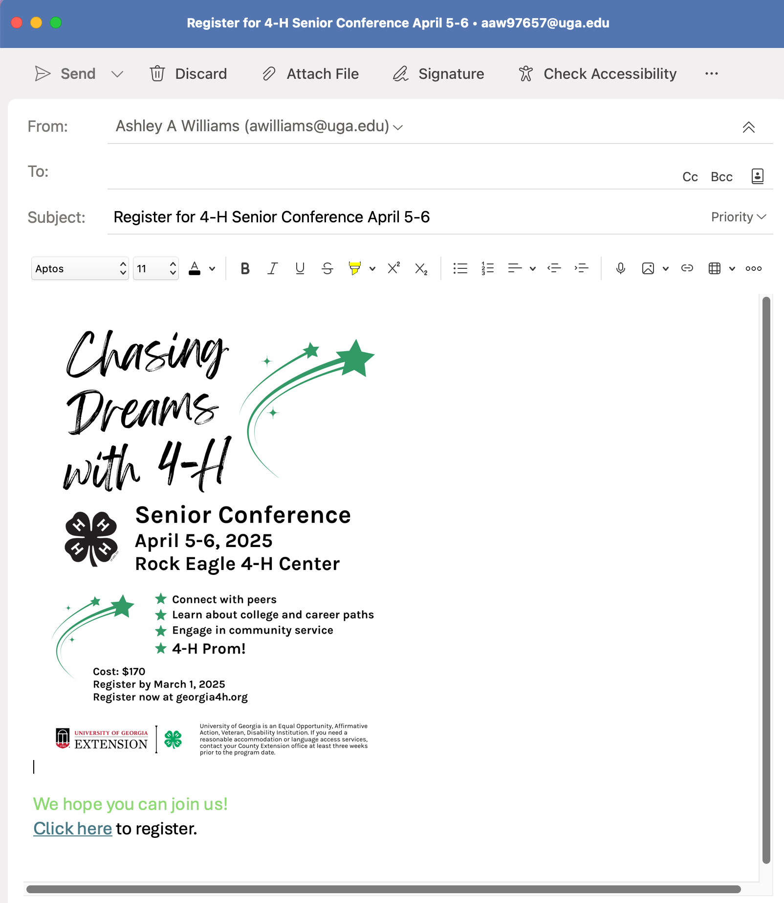
I exported a template of a flyer from Canva and put it in the body of my email.
I added some text, and a link that says “click here” to register.
It looks good, but there are accessibility issues!
Notes:
Scenario: You’re preparing an email or newsletter about an upcoming event.
Here’s our email, ready to promote [NAME OF FICTIONAL EVENT HERE].
I made the graphic using Canva. It looks nice, right?
But there are issues! Let’s go over those.

Slide 16
Don’t use images of text!
Images of text cannot be read by screen readers.
Avoid using images of text on your website, in email, documents, etc!
Instead, provide the same information as text.
Exceptions
Images of logos
Promotional images with brief text like a call to action
In either exception, the alt text must include the text on the image

Slide 17
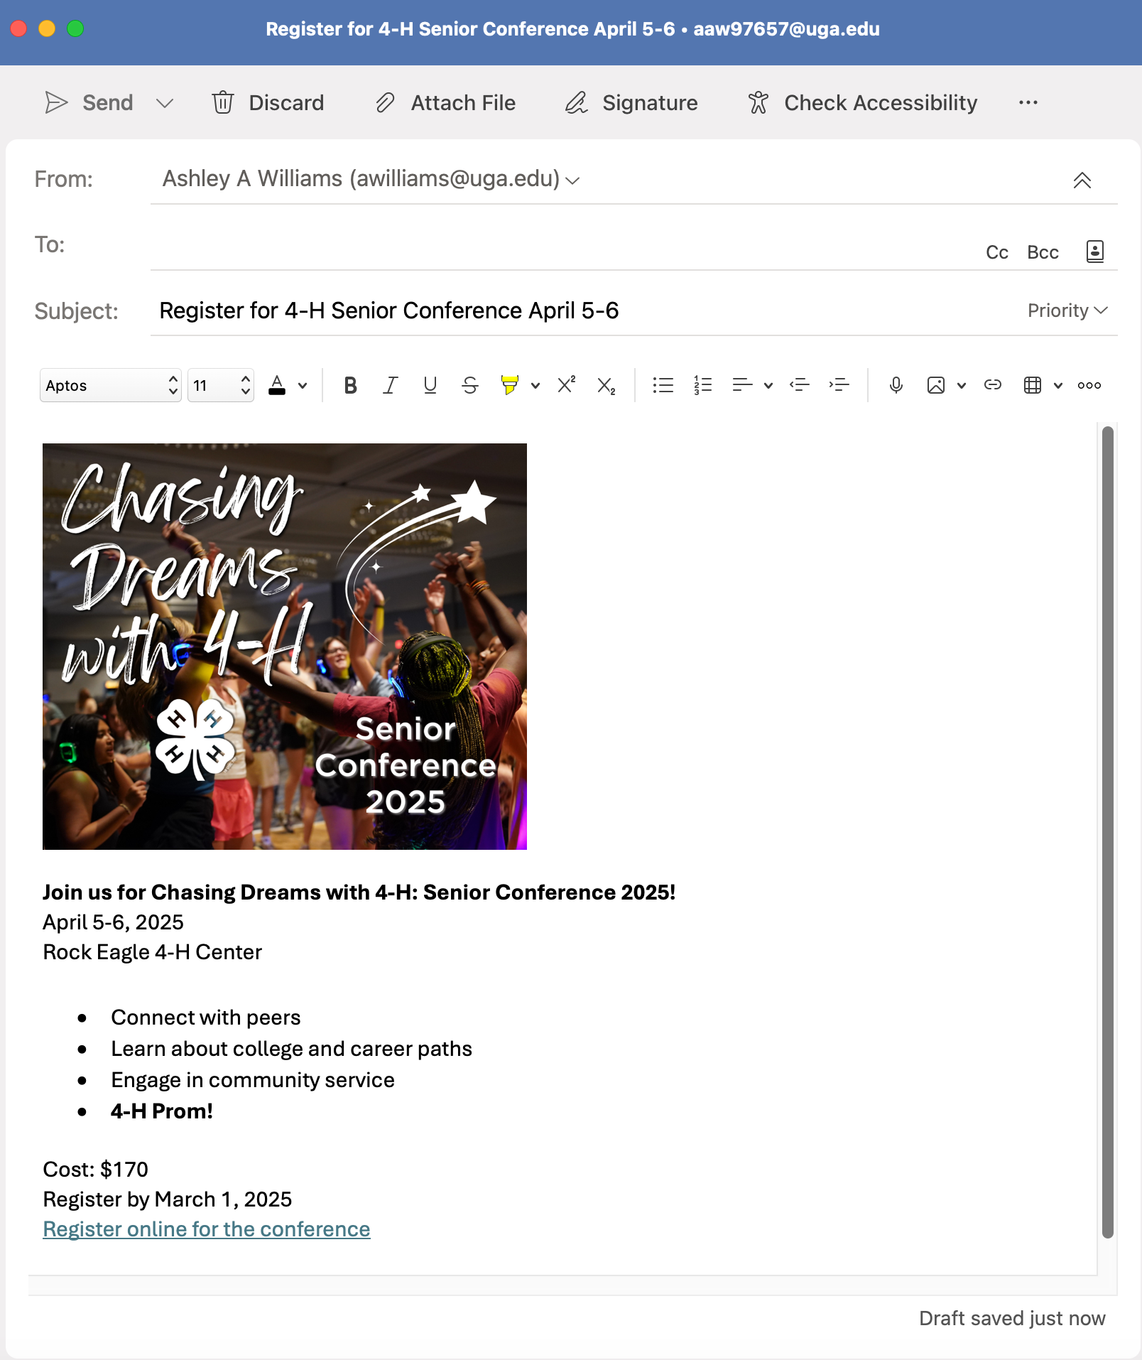
Correct Example
Eye-catching header graphic with a little bit of text (and alt text)
Important information is included as text in the body of the email

Slide 18
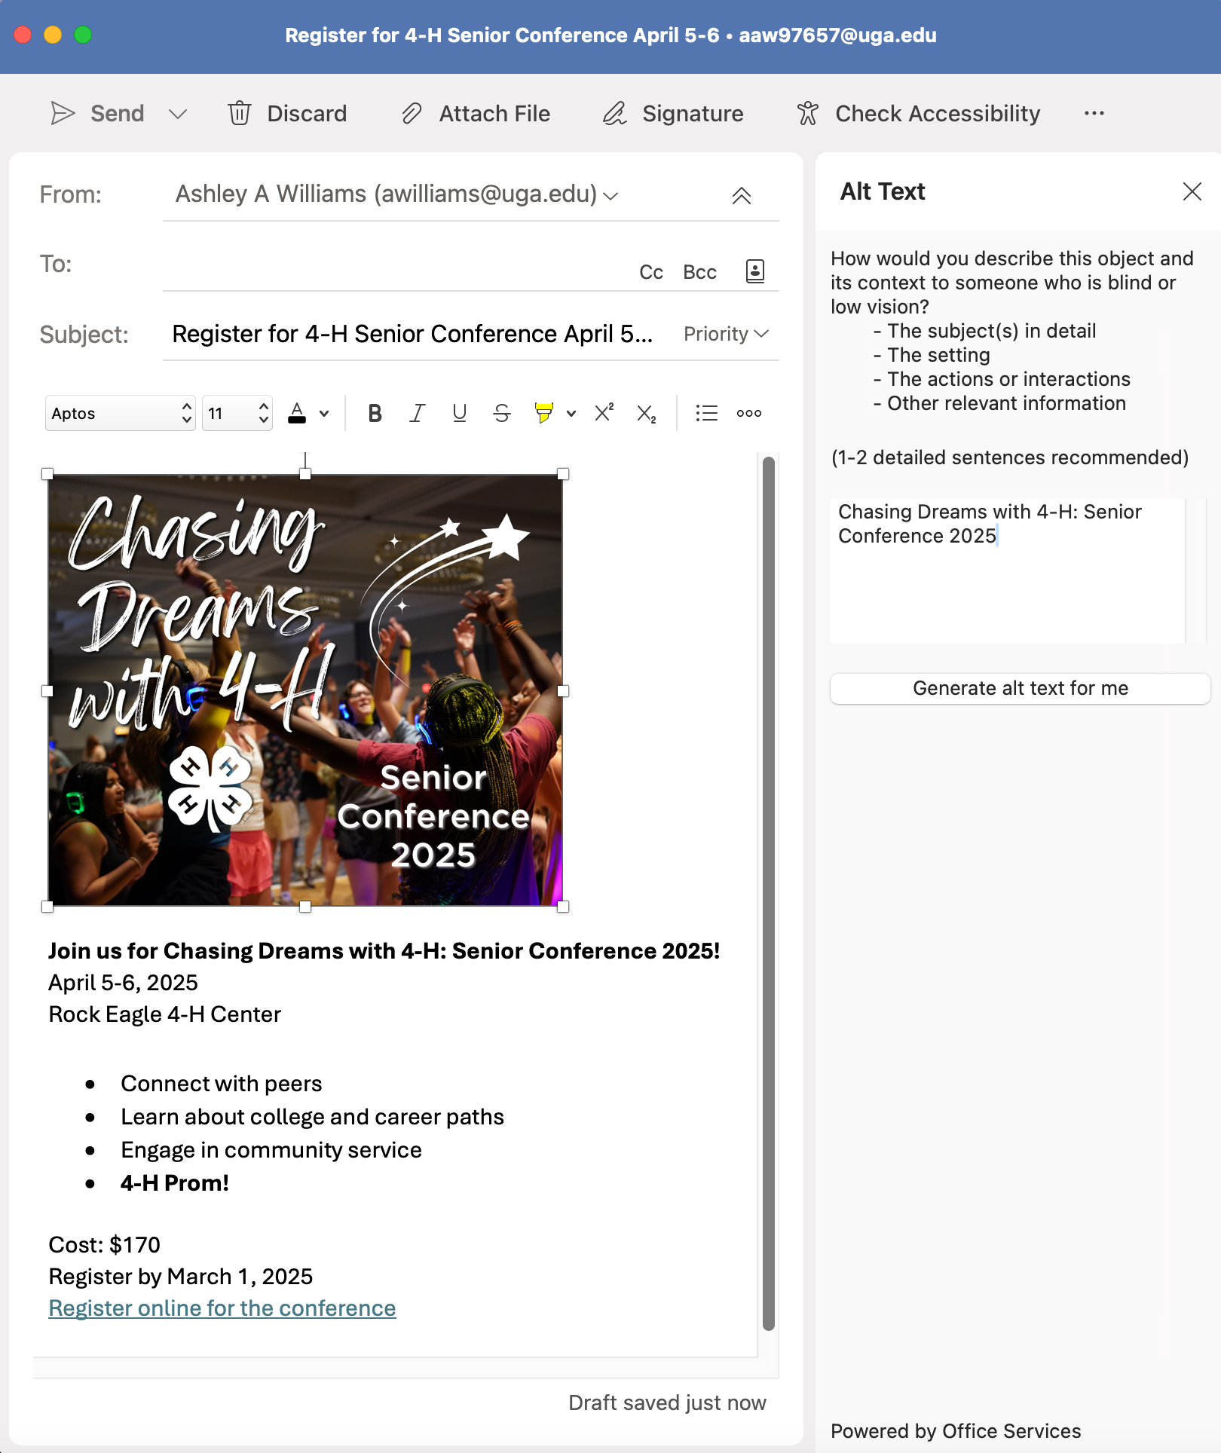
Include alt text on images
Alt text is invisible text that is read aloud by a screen reader. It should either:
Describe what the image is of
OR, include the brief text is on the image, if any
Example
The alt text for the image is: “Chasing Dreams with 4-H: Senior Conference 2025”

Slide 19
Use enough color contrast
Hard to read:
Light color text over a white background
Black text on a white background is good!
Minimum color contrast ratio:
4.5:1 for normal text and 3:1 for large text
How do I check color contrast?
Use this tool to check the contrast ratio between two colors: WebAIM’s Contrast Checker
Video Demo: How to check color contrast
This light green text does not have enough contrast.
Notes:
Hard to read:
Placing text over busy backgrounds, like over a detailed photo
Also, using low contrast combinations of text color and background color
Example: Black text on a white background is an example of high contrast. But light gray text on a white background will have low contrast.
There’s a tool that will help you figure out the contrast ratio between two colors on WebAIM’s site. It lets you know if the color’s contrast will pass or fail for accessibility purposes.

Slide 20
High Contrast
Low Contrast

Slide 21
Link text should be descriptive
Make link text concise, but descriptive.
Link text should convey the destination even out of context.
Ask yourself: If you read the link text out of context, does it tell you where you're going?
DON’T do this:
Click here
Learn more
Here
Instead, DO this:
Register for our lunch and learn
Sign-up for the newsletter
Vegetable Garden Calendar

Slide 22
Bad example!
Good example!

Slide 23
What else do these concepts apply to?
Websites
Social media
Emails and email newsletters
Digital documents

Slide 24
Scenario #2:
You’re posting an article, along with a supporting video, to your program’s blog.
Notes:
Scenario: You’re sharing a recorded presentation on your county’s blog.

Slide 25
Concepts:
Videos need accurate captions
Headings
PDFs: do you need them?
Notes:
Scenario: You’re preparing an email or newsletter about an upcoming event.

Slide 26
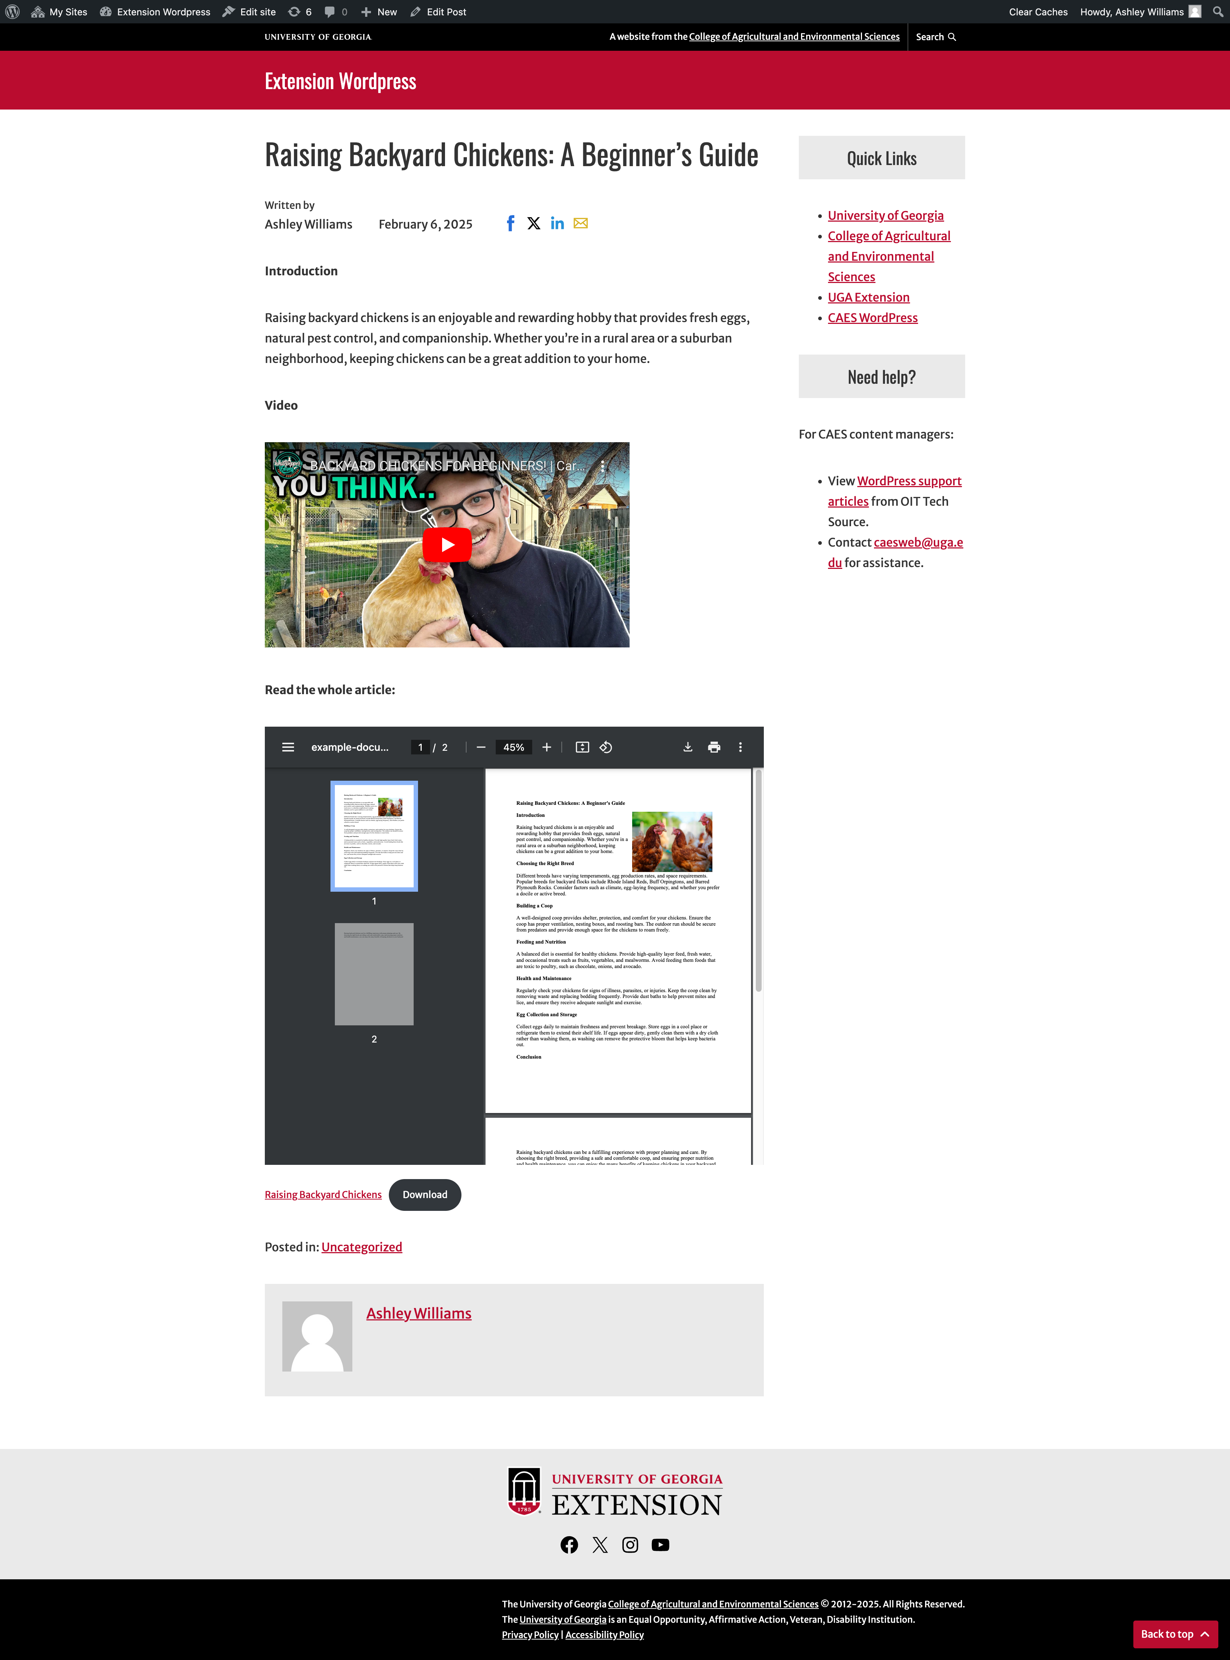
I wrote an article in Microsoft Word, saved as PDF, and embedded the PDF in the post.
I embedded a supporting video.
I separated sections with titles, but in paragraph format.
There are accessibility issues!
Notes:
Scenario: You’re preparing an email or newsletter about an upcoming event.
Here’s our email, ready to promote [NAME OF FICTIONAL EVENT HERE].
I made the graphic using Canva. It looks nice, right?
But there are issues! Let’s go over those.

Slide 27
Video content must have accurate captions!
Our recommended video host, YouTube, applies auto-captions
Review and fix any auto-generated closed captions for grammar and accuracy!
Guide for correcting YouTube captions:
Captioning YouTube videos
Example of a YouTube video with captions.
Notes:
Video and audio content must always include captions and transcripts
Make sure your videos are captioned.
Auto-captions are often inaccurate. Always review and edit auto captions, especially on YouTube.
When embedding audio content (like podcasts) be sure to provide a text transcript as well.

Slide 28
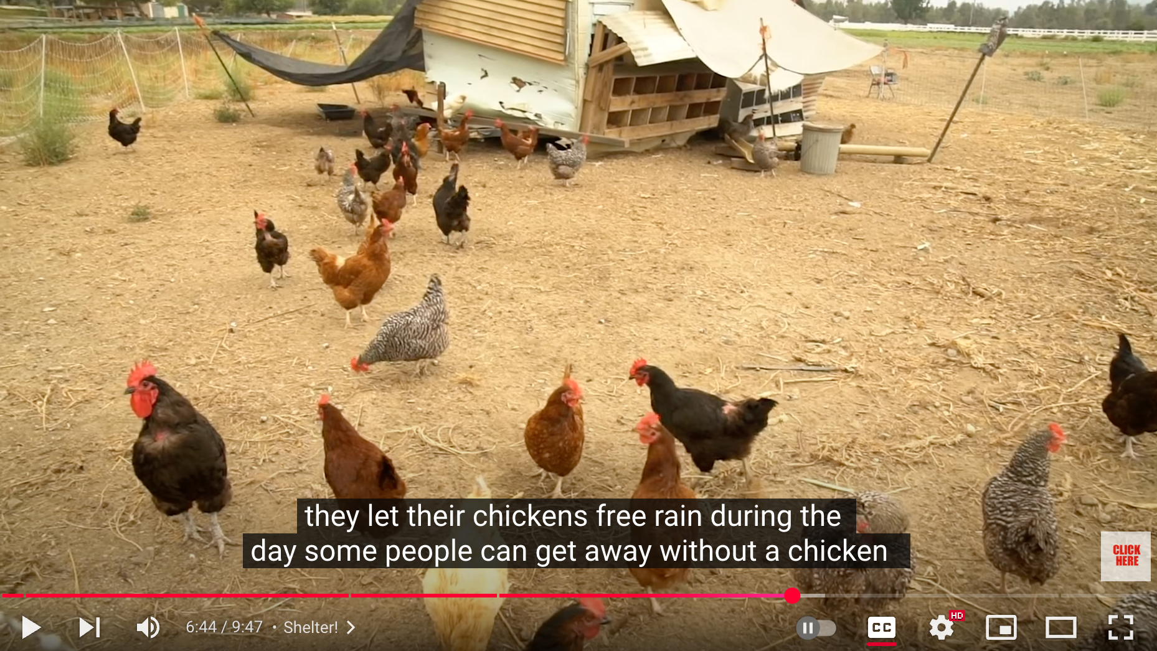
DON’T do this:
Instead, DO this:
Auto-captions have not been fixed. “Free rain” instead of “free range.”
No punctuation or capitalization.
Typos are corrected.
Proper capitalization and punctuation.

Slide 29
Ask yourself: do you really need a PDF?
PDFs are harder to make accessible compared to web pages
PDFs are not mobile friendly (over 50% of our traffic is from phones)
Scenarios where you need a PDF:
Optimized for print
Forms
We linked the PDF for most of the information… but is it accessible?
Notes:
Do you really need a PDF?
PDFs can be harder to make accessible compared to web pages
They are not very mobile friendly. If you’ve ever tried to read a PDF on your phone before then you’ve probably noticed that you had to pinch and zoom in a lot.
In general, we recommend that you avoid using PDFs when possible and use your web site’s rich text capabilities instead. Then it’s easier to make accessible AND mobile friendly.
There are scenarios when a PDF is the best choice, and that would be for anything you want to print and have handed in, like forms.
PDFs can be very optimized for print.

Slide 30
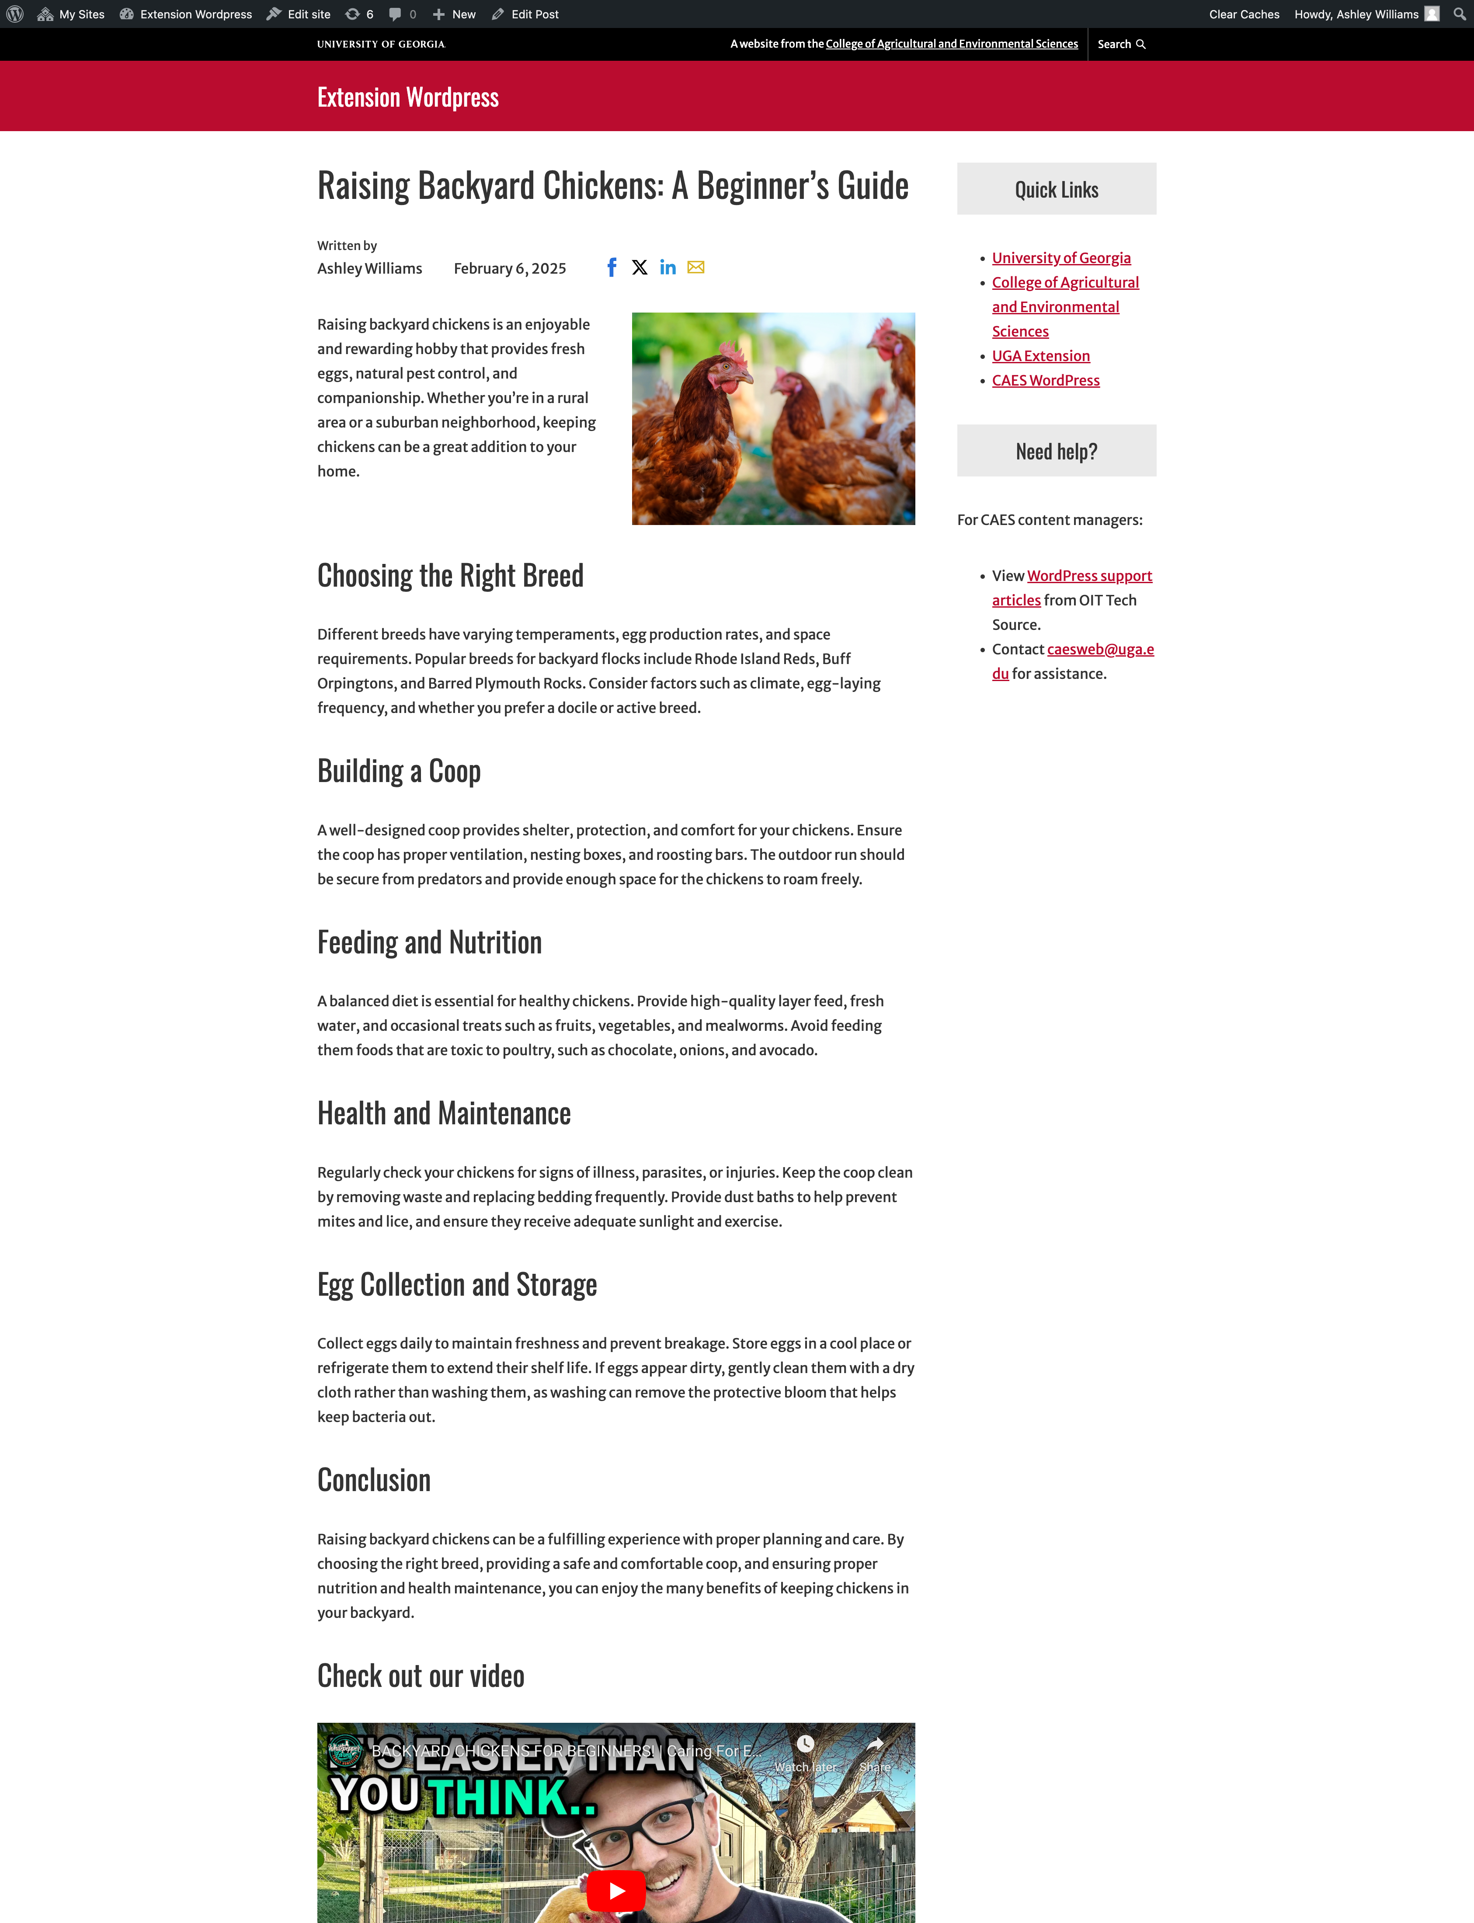
An alternative to PDFs
Instead, post the article as text in the body of your website post!
Notes:
Do you really need a PDF?
PDFs can be harder to make accessible compared to web pages
They are not very mobile friendly. If you’ve ever tried to read a PDF on your phone before then you’ve probably noticed that you had to pinch and zoom in a lot.
In general, we recommend that you avoid using PDFs when possible and use your web site’s rich text capabilities instead. Then it’s easier to make accessible AND mobile friendly.
There are scenarios when a PDF is the best choice, and that would be for anything you want to print and have handed in, like forms.
PDFs can be very optimized for print.

Slide 31
Other options
If you must use a PDF online, we have a self-paced training: ESTUDY-000139 | Self-Paced PDF Accessibility
If you’re unsure how to translate your PDF to a webpage, reach out to the Web Team at: caesweb@uga.edu
Notes:
Do you really need a PDF?
PDFs can be harder to make accessible compared to web pages
They are not very mobile friendly. If you’ve ever tried to read a PDF on your phone before then you’ve probably noticed that you had to pinch and zoom in a lot.
In general, we recommend that you avoid using PDFs when possible and use your web site’s rich text capabilities instead. Then it’s easier to make accessible AND mobile friendly.
There are scenarios when a PDF is the best choice, and that would be for anything you want to print and have handed in, like forms.
PDFs can be very optimized for print.

Slide 32
Use Headings to Outline Content
Headings are section titles on a webpage that provide a logical hierarchy for the content.
Heading 1: The main title of the page.
Heading 2: Major section or topic titles.
Headings 3-6: Subsections and subtopics that fall under Heading 2 sections, in descending order.
This Word document uses heading styles (blue text) to outline the content.

Slide 33
Heading styles on a UGA Extension county website.
Notes:
Use heading 1 once, for the title of your document
Use heading 2 for topics
Use heading 3 to outline any subtopics under each topic
… and so on.
You can nest heading levels (up to heading 6) as sub-sub-topics, if necessary.

Slide 34
A visual representation of the outline provided by a screen reader for a webpage's headings.
Notes:
Use heading 1 once, for the title of your document
Use heading 2 for topics
Use heading 3 to outline any subtopics under each topic
… and so on.
You can nest heading levels (up to heading 6) as sub-sub-topics, if necessary.

Slide 35
Don’t Use Heading Formats to Emphasize Text!
Screen readers use headings to help the user navigate information on the page!
Headings applied to for visual emphasis can make the document harder to read for users who rely on assistive technology.
Don’t do this!
Instead, do something like this:

Slide 36
Our improved article uses headings!
The title of our article is a Heading 1.
Each section title of our article is in Heading 2 format.
Notes:
Do you really need a PDF?
PDFs can be harder to make accessible compared to web pages
They are not very mobile friendly. If you’ve ever tried to read a PDF on your phone before then you’ve probably noticed that you had to pinch and zoom in a lot.
In general, we recommend that you avoid using PDFs when possible and use your web site’s rich text capabilities instead. Then it’s easier to make accessible AND mobile friendly.
There are scenarios when a PDF is the best choice, and that would be for anything you want to print and have handed in, like forms.
PDFs can be very optimized for print.

Slide 37
Scenario #3:
You are giving a presentation over Zoom.
Notes:
Scenario: You are giving a presentation over Zoom.

Slide 38
Captioning for live presentations
Two options:
Zoom - “Live Transcription” during meetings/webinars
Microsoft PowerPoint – Subtitles during presentation
For best results:
Use a headset with a microphone
Speak clearly
Have a reliable internet connection
Guide for captions in PowerPoint:
Live Captions & Subtitles in PowerPoint
Notes:
You have a couple of automated caption options:
Zoom automated captions
PowerPoint subtitles

Slide 39
Digital Accessibility Handbook
oit.caes.uga.edu/accessibility
Best Practices: Guidelines for headings, images, links, tables, color usage, video, and audio.
Training Courses:
Web Accessibility Course (for website managers)
PDF Accessibility Course
Software Guides & Tools: Accessibility best practices for Microsoft Office, video/audio, social media, email newsletters, and Canva.
Notes:
Paste the link in the chat: oit.caes.uga.edu/accessibility

Slide 40
Training Opportunities – sign up in ETS
Self-Paced Web Accessibility for Website Content Managers
This self-paced course is required for all current and new CAES and UGA Extension website content managers. Web accessibility is a fundamental principle of inclusion and equal opportunity.
Sign-up for Web Accessibility Course
Self-Paced PDF Accessibility Course
This self-paced course is available to all CAES and UGA Extension faculty and staff. If you distribute digital PDF documents on a website, by email, over social media, or any other digital means, this course is for you.
Sign-up for PDF Accessibility Course
Notes:
Paste the link in the chat: oit.caes.uga.edu/accessibility

Slide 41
Questions?
Have questions about digital accessibility?
Need help with your website?
Notes:
AUDIENCE QUESTION

