Slide 1
Web Accessibility Compliance
Website Content Manager Series:

Slide 2
Housekeeping
Attendees, please:
Mute yourself
Type your full name in the chat
Use chat for questions
We will record this session
Ashley Williams Web Developer
CAES Office of Information Technology
Notes:
Just a couple of housekeeping items:
Attendees, please mute yourself
Type in your full name in the chat for attendance, so we can give you credit in ETS
If you have questions, please use the chat. We will take time at the end to answer them
We will be recording this session and sending it out after
Introductions

Slide 3
Overview
Understanding Web Accessibility
What it is, who does it affect
Compliance, legal liability
Accessibility Best Practices for Content Managers
Q&A
Office of Information Technology
Notes:
Just a quick overview of what we'll be going over today:
Understanding Web Accessibility: what it is, who it affects, compliance, legal liability
We’ll talk about what specific best practices content managers can implement as you edit your websites
Q&A

Slide 4
Understanding Web Accessibility

Slide 5
What is Web Accessibility?
Web accessibility is the inclusive practice of making websites usable by people of all abilities and disabilities.
All users should have equal access to the information on our sites.
Office of Information Technology
Notes:
What is Web Accessibility? It is the inclusive practice of making websites usable by people of all abilities and disabilities.
Think of how we make public spaces accessible with things like ramps. Web accessibility best practices are like the ramps for websites.
So when we design our websites with accessibility in mind, all users have equal access to the information on them.

Slide 6
Who is impacted?
26% of adults in the United States have some type of disability.
Disability becomes more common with age, affecting about 2 in 5 adults age 65+
27.2% of Georgians have some type of disability
Did you know?
A recent survey has found that 71% of disabled users simply leave a website that’s not accessible
Office of Information Technology
Notes:
So who is impacted by accessibility issues?
According to the CDC, 26% of adults in the United States have some type of disability.
Disability becomes more common with age, affecting about 2 in 5 adults age 65 and older
In Georgia, 28% of adults have some type of disability.
This is a large chunk of our audience!
This fact becomes even more important to consider when about 71% of disabled users will simply leave a website if it’s not accessible
Sources: CDC (https://www.cdc.gov/ncbddd/disabilityandhealth/infographic-disability-impacts-all.html, https://www.cdc.gov/ncbddd/disabilityandhealth/impacts/georgia.html)
Source: Click-Away Pound Survey (http://www.clickawaypound.com/cap16finalreport.html)
Updated 01/07/2022

Slide 7
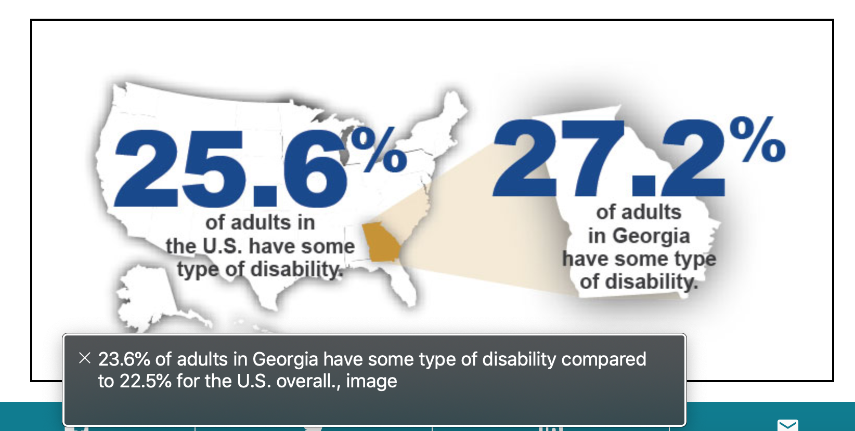
Notes:
- “Fun” story, while I was making this presentation, I found this graphic on the CDC’s website about disabilities in Georgia.
I noticed that the alt text on the image did not match the stats in the graphic – meaning a person using a screen reader would get out of date stats about disabilities!
The same stat wasn’t provided anywhere else on the page in text.
Just wanted to share this real-world example of why being diligent about accessibility is important.

Slide 8
Who is impacted?
The community of website users with disabilities or impairments is wide-ranging.
Still, many web accessibility issues can be broken down into these categories:
Auditory - Difficulty hearing, deafness and hearing impairments
Cognitive - Conditions that affect the brain’s memory, attention or ability to interpret information
Motor - Various forms of paralysis caused by injury, congenital conditions and tremors.
Visual - Low vision, blindness, or color blindness caused by various eye conditions.
Office of Information Technology
Notes:
Keep in mind, it’s hard to define every issue, or every type of user who will run into accessibility problems on your website.
The community of website users with disabilities or impairments is wide-ranging and diverse.
Still, many accessibility issues can be broken down into these categories:
Auditory – Difficulty hearing, deafness and hearing impairments
Example issue: a video embedded on a web page does not have captions
Cognitive – Conditions that affect the brain’s memory, attention or ability to interpret information
Example issue: a website where the content has poor readability and is difficult to navigate
Motor – Various forms of paralysis caused by injury, congenital conditions and tremors.
An example of an issue would be a website that does not support keyboard navigation for important controls, like opening and closing menus.
Visual – Low vision, blindness, or color blindness caused by various eye conditions.
An example of an issue can be low contrast colors used on a web page, making the text hard to read against the background.

Slide 9
Compliance
Section 508 of the Rehabilitation Act
These standards are aligned with worldwide guidelines (WCAG 2.0)
Since Georgia receives federal funding from the Assistive Technology Act, Section 508’s regulations apply to USG institutions, including CAES and UGA Extension
Office of Information Technology
Notes:
One of our reasons for maintaining accessible websites is COMPLIANCE
Section 508 of the Rehabilitation Act provides standards that must be followed by federal agencies when creating web-based content.
Example: every non-text element must be accompanied by a text equivalent for those who are not able to see, hear or otherwise access the non-text element.
Section 508 standards are aligned with global guidelines. Web accessibility guidelines are an international effort.
Since the state of Georgia receives federal funding under the Assistive Technology Act, the Board of Regents of the University System of Georgia (USG) has determined that Section 508’s regulations apply to USG institutions, including CAES and UGA Extension.
Updated 02/07/2022

Slide 10
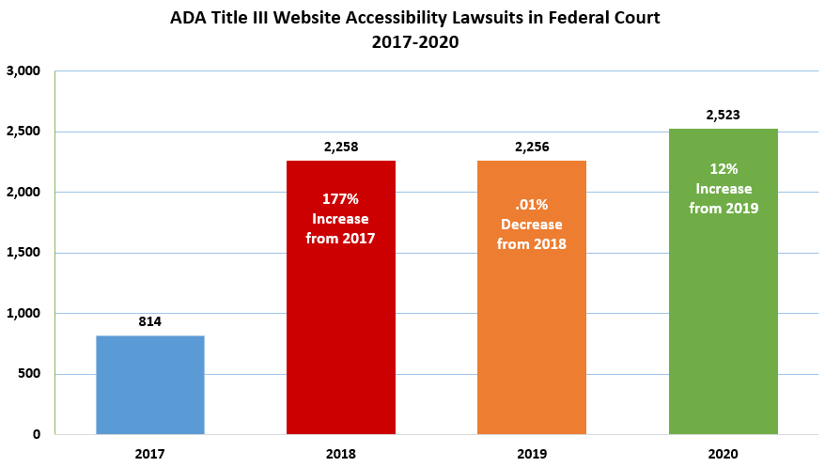
Legal Liability
Website Accessibility Lawsuits
Increased legal accountability
Website accessibility lawsuits increased 177% from 2017 to 2018
2020: 2,523 website accessibility lawsuits
Office of Information Technology
Notes:
Another concern is legal liability
Over the past couple of years, organizations have been increasingly held legally accountable for making their websites accessible
The number of ADA title III lawsuits increased 177% from 2017 to 2018
In 2020 there were 2,523 accessibility lawsuits
Legal liability can be a real consequence of inaccessible websites, and is another reason to do our due diligence
Source: Seyfarth ADA Title III Blog (https://www.adatitleiii.com/2021/04/federal-website-accessibility-lawsuits-increased-in-2020-despite-mid-year-pandemic-lull/)
Updated: 01/07/2022

Slide 11
Other Benefits of Accessibility
Accessible websites are easier for EVERYONE to use and understand
Headings make pages easy to skim
Captions make videos easier to watch in noisy settings
Accessibility = Search Engine Friendly
Accessible websites lead to more “conversions”
Easy to find contact info = easier to contact your county office
Office of Information Technology
Notes:
There are other benefits of web accessibility
Accessible websites are easier for EVERYONE to use and understand
Ex: a page outlined with section headers is easier to skim and find what you’re looking for
Ex: Captions on a YouTube video are helpful when you’re trying to watch a video in a noisy setting, like a shared office
Accessibility is search engine friendly
Google uses a robot to read our websites, similar to how a screen reader works. If our site is accessible, that means our sites are more search engine optimized
We can reach a wider audience when we use best practices – which leads to more “conversions”, or business goals met
A conversion can be something like a user is able to find contact information for their local county office, and calls or visits the office

Slide 12
Content Manager’s Responsibility
What accessibility best practices should content managers use when creating webpages?
Alt text for images
Captions for video
Transcripts for audio
Descriptive link text
Headings that organize content on the page
Tables
PDFs that are “tagged” and easy to read
Office of Information Technology
Notes:
- As a content manager, what is your responsibility regarding web accessibility on your website?
The best practices we’re going over today are
Alt text for images
Captions for video
Transcripts for audio
Descriptive link text
Headings that organize page content
Tables
PDFs that are tagged and easy to read

Slide 13
Web Accessibility Best Practices for Content Managers

Slide 14
Navigating a webpage with a Screen Reader
A screen reader is an assistive technology, primarily used by people with vision impairments.
It converts text, buttons, images and other screen elements into speech or braille.
Demo: Quick overview of navigating a webpage with a screen reader
Office of Information Technology
Notes:
Users with disabilities use different assistive technology to browse the web.
Assistive technology includes all kinds of different tools, but today we’ll be focusing on screen readers.
A screen reader is primarily used by people with vision impairments.
It takes screen elements, like text, buttons, and images, and converts them into speech or braille.
So while we’re talking about best practices today, I’ll be sharing some screen reader demos that I’ve recorded
You don’t have to know how to use a screen reader, but I think seeing one in action will put why we do accessibility best practices into context.

Slide 15
Best practices for images
Images on your webpages must include Alt Text
Alt text describes or provides a description of images
Graphs or diagrams should have accompanying text that described their meaning
If the image is linked, the alt text should let the user know where the link will take them
Demo:
What does a screen reader do when an image doesn’t have alt text?
Office of Information Technology
Notes:
Images on your webpages must include Alt Text
Alt text provides a description of what the image is of
Alt text doesn't have to be long, but it should accurately describe the image
When using images of graphs or diagrams, include accompanying text to explain the information
And if you’re linking an image, the alt text should explain where the user will go if they click the link

Slide 16
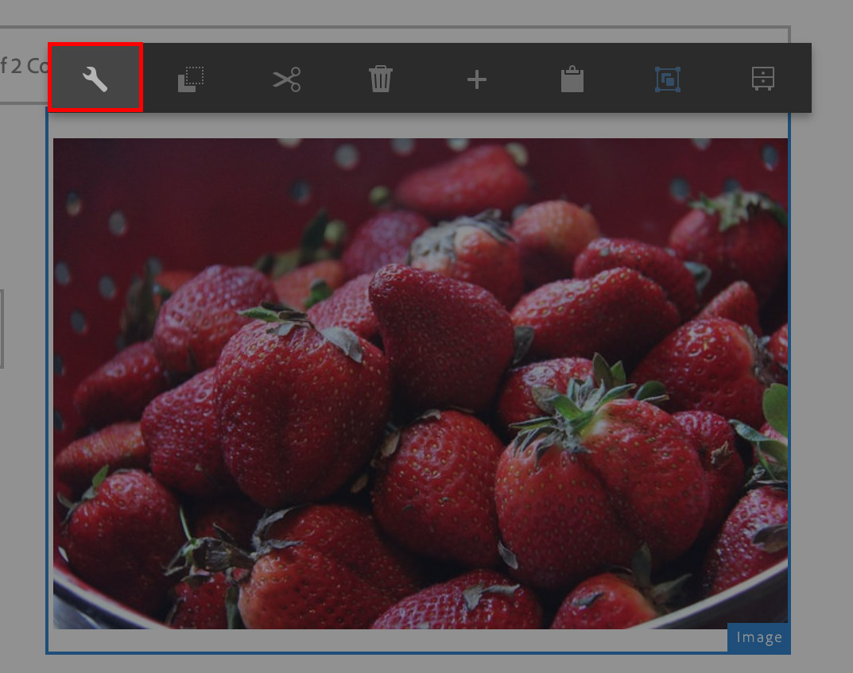
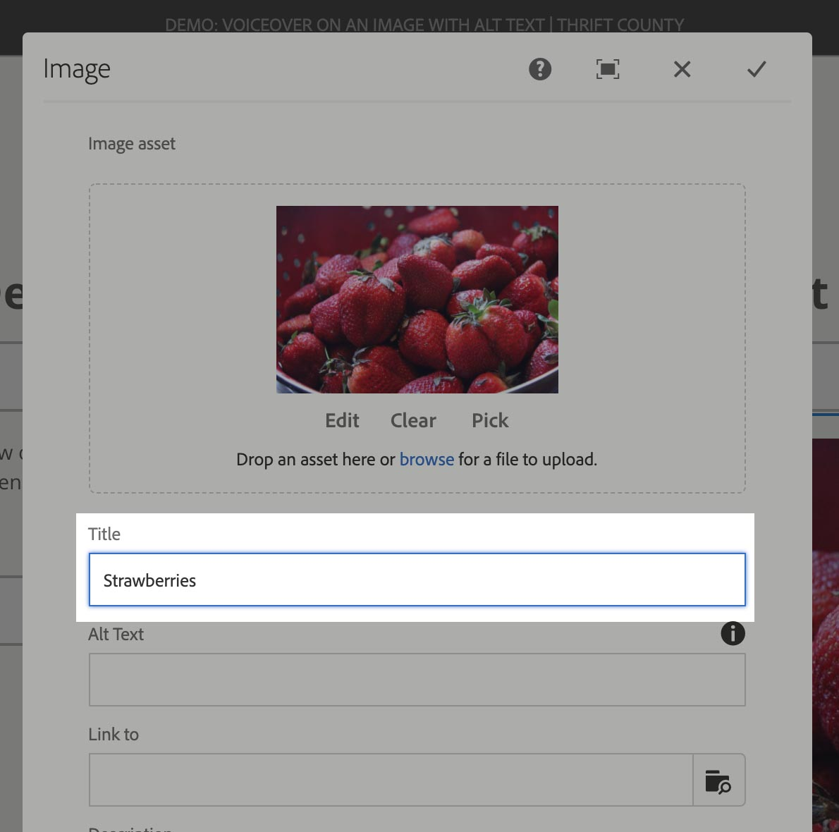
Adding alt text to an image in AEM
Notes:
Adding alt text to an image in AEM
Step 1: Select your image component in AEM, and click the wrench icon from the toolbar.
Step 2: In the Image’s settings, put your description text in the Title field. Note that there is an alt text field, but in AEM you only have to fill out Title and it will cover the Alt text as well.

Slide 17
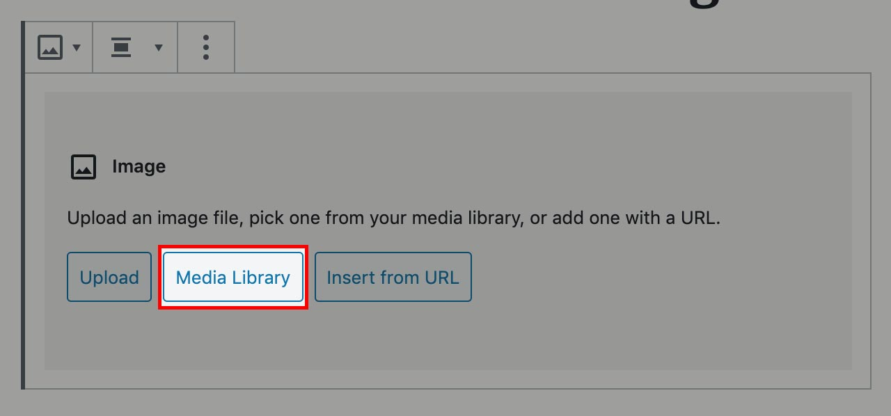
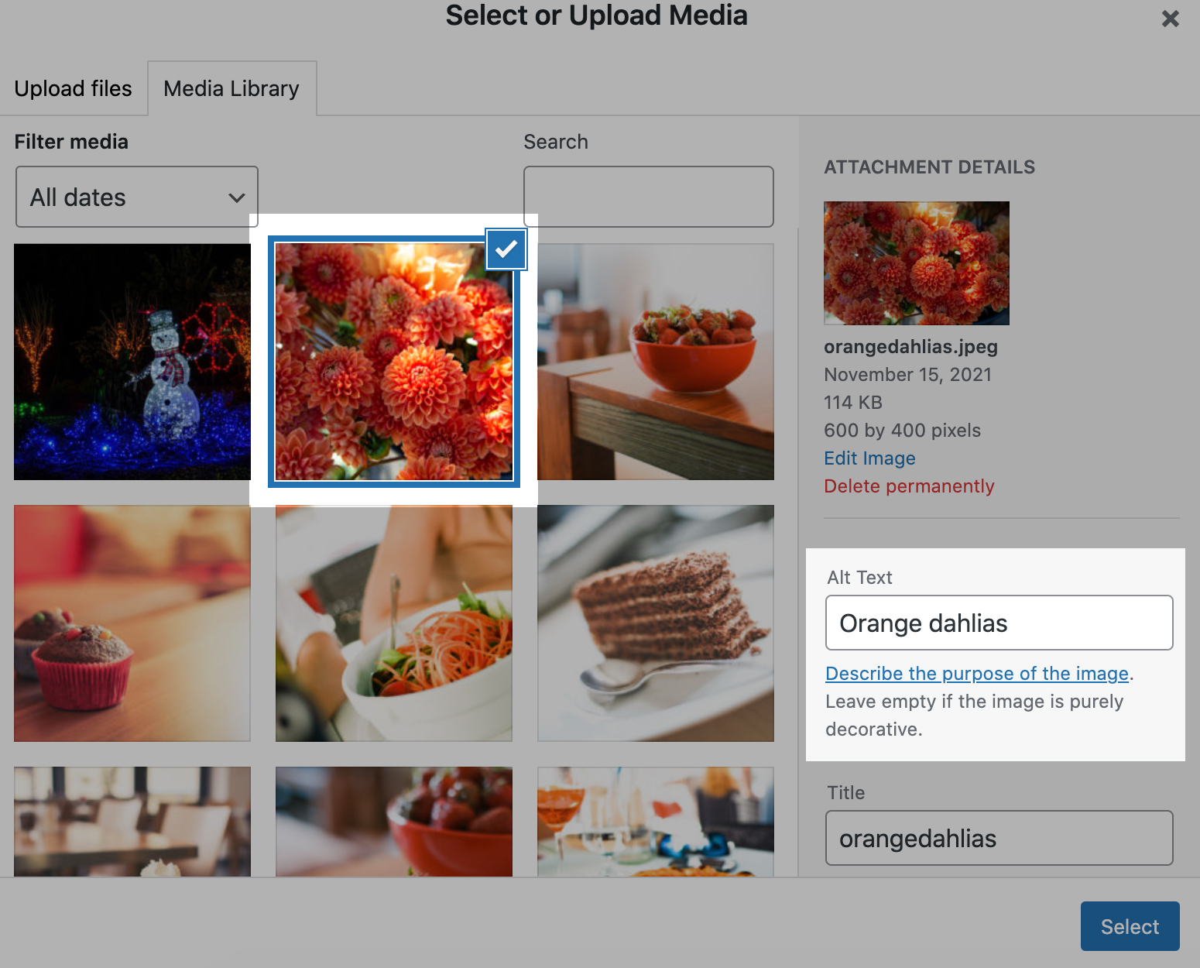
Adding alt text to an image in WordPress
Notes:
Adding alt text to an image in WordPress
Step 1: After inserting an image block, select the Media Library button.
Step 2: In the Media Library, select an image. Once selected, on the right you’ll have a field to type in the alt text.

Slide 18
Best practices for images
Image Sliders and Galleries
Make sure all images have alt text or captions
If there isn’t an alt text field, use the “title” or “caption” field instead
If the image slide is linked, you can phrase the alt text, title, or caption to be a call to action instead of a description
Office of Information Technology
Notes:
Just like single images, image galleries and sliders need to have alt text or captions for each image
Fields names may vary in AEM or WordPress, but you're typically looking for a "title" or "caption" field
If the slide is linked, you can even phrase the alt text or caption as a call to action
For example, a call to action could be: “Learn More About Our Programs”

Slide 19
Best practices for images
Don’t use images to convey text!
Don’t just use images of text to convey information! Ex: images of flyers
Screen readers can only read alt text
Instead, make sure the information is included via text on the web page
Exception to the rule: images of logos
Demo:
What happens when text is in an image, but not provided as text on the page?
Office of Information Technology
Notes:
Another important best practice: Don’t use images to display text!!!
A screen reader can’t read the text displayed in images, it can only read the ALT text
Provide a text alternative on the page for flyers
The exception to the rule are images of logos. In the case of a logo, you will just want to make sure the image includes alt text

Slide 20
Best practices for video and audio
Video and audio content must always include Captions and Transcripts
Provide captioning for videos
Review any auto-generated closed captions for accuracy
Provide a transcript of audio content
Office of Information Technology
Notes:
Video and audio content must always include captions and transcripts
Make sure your videos are captioned. In AEM, we have a checkbox on YouTube components where you verify that a video has been captioned, since it is a compliance requirement.
Auto-captions are often inaccurate. Always review and edit auto captions, especially on YouTube.
When embedding audio content (like podcasts) be sure to provide a text transcript as well.

Slide 21
Best practices for video and audio
How to: Caption YouTube Videos
Method 1: Work with CAES Office of Marketing and Communications
Contact OMC about your video project
Make your video, and send to OMC to upload to YouTube
OMC will send you the auto translated script for you to make corrections
Send transcript back to OMC
Office of Information Technology
Notes:
Easiest method is working with the Office of Marketing and Communications
Let OMC know about your upcoming video project – they can advise on video production, hosting, captioning, and marketing
Send your video to OMC and they will upload it to the UGA Extension YouTube channel
They will send a transcript back to you for you to review and correct
Send corrected transcript back to OMC, they’ll apply it to the video

Slide 22
Best practices for video and audio
How to: Caption YouTube Videos
Method 2: Do-it-yourself
Demo: Adding Captions to a YouTube Video after uploading
Office of Information Technology
Notes:
- Method #2 is do-it-yourself
- If your area already has a YouTube channel, you can upload the video yourself and edit the captions before sharing

Slide 23
Best practices for links
Links should be descriptive!
Link text should make sense out of context
Avoid links like “read more” or “click here”
Demo:
What happens when there are a bunch of “click here” links on a page?
Office of Information Technology
Notes:
Links should be descriptive!
Link text - that's the text you highlight to create a link on a page - should be descriptive
Try reading your link text out loud – does it tell you enough about where the link will send you, even out of context?
Avoid links like “read more” or “click here.”
These types of links don't mean anything out of context and will be useless for screen reader users.

Slide 24
Link Text Don’ts
Link Text Dos

Slide 25
Best practices for headings
Headings should be used to break up and organize content
Headings help users quickly scan a page and find sections by topic
Don’t use headings on entire paragraphs.
Don’t skip heading levels Ex: Don’t use heading 2 to begin a section, and then immediately use heading 4 for subsections. Use heading 3 instead.
Demo:
What happens when heading styles are used incorrectly?
Office of Information Technology
Notes:
Headings are the format styles you use to outline the beginning of sections on a page (heading 2, heading 3, etc)
Headings help users quickly scan a page and find sections by topic.
Don’t use headings on entire paragraphs. Using heading styles simply for emphasis (because it makes the font larger) creates accessibility issues.
Don’t skip heading levels. Ex: Don’t use heading 2 to begin a section, and then immediately use heading 4 for subsections. Use heading 3 instead
It may seem trivial to use them out of order, but since headings provide structure for navigating the page to screen reader users, skipping a heading level can cause confusion.

Slide 26
Best practices for tables
Use tables for representing data (Not for visual layout!)
For basic tables, use table headers and captions
Avoid creating complex tables when possible
Making an accessible table can be complicated. If you need to include a table, please reach out to caesweb@uga.edu to make sure the table is accessible.
Office of Information Technology
Notes:
Best practices for tables on your webpage.
Use tables for data – not for visual layout. For visual layout, we can use columns in AEM and WordPress.
For basic tables, use table headers and captions
Avoid creating complex data tables when possible. The more complex your table structure is, the harder it is to make it accessible.
Even if it’s a simple table, making it accessible can be complicated. If you need to include a data table, please reach out to the Web Team to make sure the table is set up properly for screen readers.

Slide 27
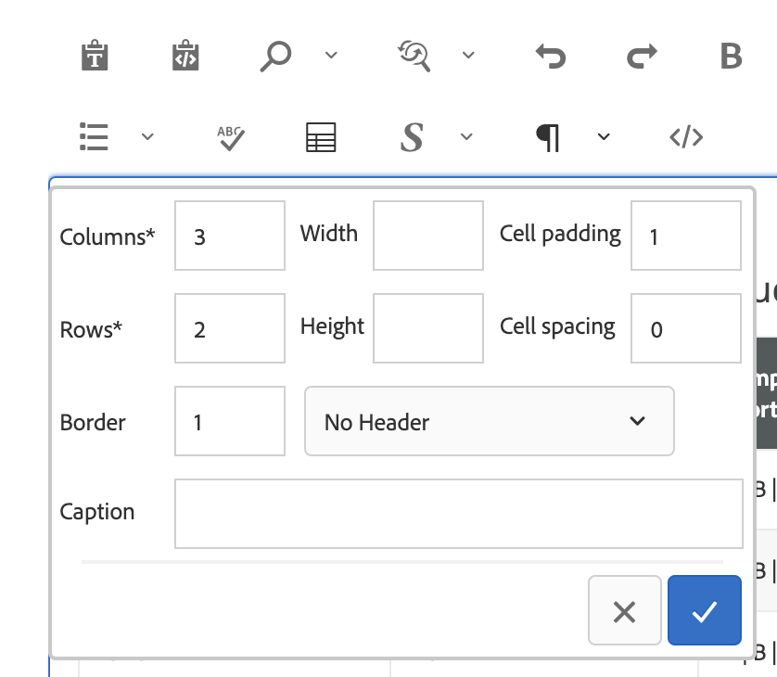
Adding table headers and captions in AEM
Select if the table has a header row or column
The caption is like a header for the table
Notes:
In AEM you can specify if the table has a header column or row (we’ll see an example in the next slide)
You can also add a table caption, which functions like the heading of the table.

Slide 28
Caption
Header row

Slide 29
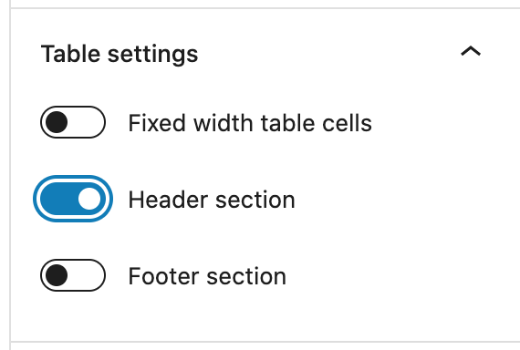
Adding table headers in WordPress
Select if the table has a header row
Notes:
WordPress keeps it simple, with only the option to turn on the header section for a table block
Again, with tables, keep it simple and ask us for help!

Slide 30
Best practices for PDFs
Hard to read:
Text over photo backgrounds
Text over a background color that has low contrast
Check the contrast ratio between two colors:
WebAIM’s Contrast Checker
Demo: How to check color contrast
Office of Information Technology
Notes:
Make sure your PDFs are easy to read!
Hard to read:
Placing text over busy backgrounds, like over a detailed photo
Also, using low contrast combinations of text color and background color
Example: Black text on a white background is an example of high contrast. But light gray text on a white background will have low contrast.
There’s a tool that will help you figure out the contrast ratio between two colors on WebAIM’s site. It lets you know if the color’s contrast will pass or fail for accessibility purposes.
Let’s look at the video demonstrating how to check these for a flyer

Slide 31
Best practices for PDFs
Accessible PDFs should have “tags”
Tags - invisible, structured data that conveys the PDF’s information to a screen reader
PDFs created in Word automatically have tags
However, tags in PDFs must be checked using Foxit PDF Editor or Adobe Acrobat Pro
WebAIM’s PDF Accessibility Tutorial
Office of Information Technology
Notes:
Accessible PDFs should have “tags”
Tags are invisible, structured data that conveys a PDF’s information to a screen reader
Fortunately, PDFs created in Word automatically have tags
However, you would still want to check over the tags and run other accessibility checks using Adobe Acrobat Pro or Foxit PhantomPDF
Really, the process of making sure a PDF document is properly tagged deserves its own presentation
Since we don’t have time to go through it all today, I do have a link here to WebAIM’s tutorial for PDF accessibility.

Slide 32
Best practices for PDFs
Ask yourself: do you really need a PDF?
PDFs are harder to make accessible compared to web pages
PDFs are not mobile friendly
Scenarios where you need a PDF:
Forms
Optimized for print
Office of Information Technology
Notes:
Do you really need a PDF?
PDFs can be harder to make accessible compared to web pages
They are not very mobile friendly. If you’ve ever tried to read a PDF on your phone before then you’ve probably noticed that you had to pinch and zoom in a lot.
In general, we recommend that you avoid using PDFs when possible and use your web site’s rich text capabilities instead. Then it’s easier to make accessible AND mobile friendly.
There are scenarios when a PDF is the best choice, and that would be for anything you want to print and have handed in, like forms.
PDFs can be very optimized for print.

Slide 33
Best Practices for Web Accessibility Takeaways
Give images alt text
Don’t use images to solely convey text information – provide text alternatives
Provide captions for videos
Make link text descriptive
Use headings to organize and structure your page
Give tables header rows/columns
PDFs should be tagged and have high contrast
Office of Information Technology
Notes:
If you remember nothing else today, these are the major takeaways from best practices
Give images alt text
Don’t use images to solely convey text information – make sure your image flyers include text alternatives!
Make sure videos are captioned
Make link text descriptive – it should make sense out of context
Use headings to organize and structure your page, without using those styles on paragraphs
Give tables header rows and captions
And use PDFs sparingly, but when you do make sure they have good contrast and are tagged
I’d say those are the easy wins when it comes to making our sites more accessible

Slide 34
Questions?
Accessibility resources:
Accessibility & Section 508 articles
Web Accessibility Checklist
Two Ways to Caption YouTube Videos
Contacts
Web Team: caesweb@uga.edu
Office of Marketing and Communications
Office of Information Technology
Notes:
I hope now you have a better idea of what web accessibility is.
I hope you now have the confidence to make your website easier to use for everyone.
Any questions from the chat?
I will send my slides out soon, so you have access to the links
If you need help with your sites, contact the Web Team
If you have questions about video production, contact OMC

